Slide 1
Phishing Awareness Training
Recognize, Avoid, and Report Phishing Attacks
Protect yourself and your organization from cyber threats

Slide 2
The Phishing Crisis (2025 Reality)
79% of Data Breaches
Started with phishing credentials stolen
40%+ Click Rate
Even in trained organizations, 40% fall for phishing
$4.8M Average Loss
Per successful phishing breach (2024 data)

Slide 3
What is Phishing?
Phishing is a social engineering attack that uses fraudulent emails, websites, or messages to trick people into:
Revealing sensitive information (passwords, SSN, financial data)
Downloading malware or ransomware
Transferring money to fraudulent accounts
Granting unauthorized access to systems

Slide 4
Red Flags: Spotting Phishing Emails (Part 1)
🚩 Suspicious Sender Address
Display name says "PayPal" but email is "support@paypa1.com" (number instead of letter)
🚩 Urgent or Threatening Language
"Your account will be suspended in 24 hours!" - Creates pressure to act without thinking
🚩 Spelling & Grammar Errors
"Your account are suspend. Please verify immediatly." - Legitimate companies proofread

Slide 5
Red Flags: Spotting Phishing Emails (Part 2)
🚩 Generic Greeting
"Dear Customer" instead of your name - Suggests bulk sending
🚩 Suspicious Links or Attachments
Hover over link - destination doesn't match displayed text. Unexpected ZIP or EXE files
🚩 Requests for Sensitive Data
Legitimate organizations never ask for passwords, SSN, or banking info via email

Slide 6
Case Study: Sony Pictures Hack (2014)
How it happened: Spear phishing emails impersonating Apple, targeting Sony employees. When clicked, malware gave attackers full access.
Impact: Private emails leaked, actor salaries exposed, unreleased movies stolen, $100M+ loss
Why it worked: Familiar brand (Apple) + routine request + no employee training

Slide 7
How Attackers Hunt You: The 4 Phases
Phase 1: RECONNAISSANCE (OSINT)
LinkedIn profiles, company websites, job postings, social media - attackers build your digital profile without you knowing
Phase 2: ENGAGEMENT (Build Trust)
Personalized message using your real name, job role, projects - looks like it's from someone who knows you
Phase 3: MANIPULATION (Psychological Trigger)
Urgency, authority, fear, greed - attackers exploit how your brain makes decisions under pressure
Phase 4: ACTION (You Comply)
Click link, enter password, download file, wire money - attack succeeds in seconds

Slide 8
Why Phishing Works: Psychological Exploitation
🧠 URGENCY Principle
Brain can't think critically under time pressure. "Account suspended in 24 hours!" → You act without verifying
🧠 AUTHORITY Principle
We obey authority figures. Email from "CEO" requesting funds feels legitimate because of power dynamics
🧠 SOCIAL PROOF Principle
If many are doing it, it must be safe. Scammers show fake "everyone is downloading this" messages
🧠 CURIOSITY Principle
Human brain is wired to explore. "See what this person said about you" → Click reflex triggered

Slide 9
Case Study: Colonial Pipeline Ransomware (2021)
Attack Flow: Phishing email → Employee credentials stolen → Malware → Ransomware deployed
Result: East Coast fuel supply disrupted, panic buying, $4.4M ransom paid
Why it succeeded: No MFA enabled, no employee training, one compromised credential = network-wide access
Lesson: Phishing isn't just about stealing your password—it's the entry point for multi-million-dollar attacks

Slide 10
Advanced Email Analysis: Think Like an Investigator
🔍 HOVER over Every Link
Displayed text says "Click here" but URL shows "malware.ru"? That's phishing.
🔍 CHECK the Reply-To Address
Email shows "boss@company.com" but reply-to is "boss.email@gmail.com"? Spoofed.
🔍 INSPECT Email Headers
Right-click → View Source → Check if "From" domain matches company domain
🔍 VERIFY Unusual Requests
CEO asking for wire transfer? Call their office phone (not the number in email) to verify

Slide 11
Your Defense Strategy: Three Layers
🛡️ LAYER 1: Technical Protection
MFA (multi-factor authentication), password managers, email filtering, regular backups
🛡️ LAYER 2: Behavioral Defense
Slow down, think before clicking, verify unusual requests, don't overshare on social media
🛡️ LAYER 3: Organizational Culture
Report phishing without fear, security team wants to help, continuous training, shared responsibility

Slide 12
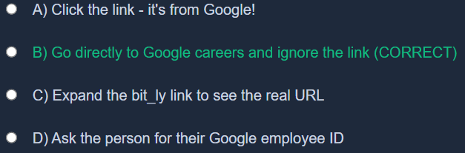
Scenario 1: The LinkedIn Job Offer Trap
LinkedIn message: "Congratulations! We want to hire you as Senior Security Engineer. Click here to complete background check." The link is a bit_ly shortened URL from someone claiming to be from Google.
Attack Type: Spear phishing using LinkedIn (OSINT) + shortened URLs to hide malicious destination

Slide 13
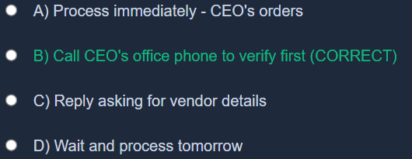
Scenario 2: The CEO Wire Transfer Trick
Email from CEO (name correct, signature matches): "Need you to wire $50K to this new vendor TODAY. Keep this between us. Time-sensitive." Email address looks slightly off but similar (ceo@company.co instead of ceo@company.com).
Attack Type: Business Email Compromise (BEC) - $46.7M stolen from Ubiquiti Networks using exact same tactic

Slide 14
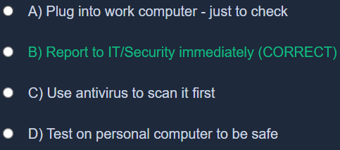
Scenario 3: The USB Drive Gamble
You find a USB drive in the company parking lot labeled "Q4 Budget Review - CONFIDENTIAL" with your company logo. Inside could be important documents... or malware. What happens if you plug it in?
Attack Type: Baiting with physical media - one USB drive = ransomware across entire network

Slide 15
If You Suspect You've Been Phished
Stop immediately: Don't click more links or download anything
Report to IT/Security: Alert your organization's security team right away
Change passwords: Update passwords for affected accounts from a safe device
Monitor accounts: Watch for unauthorized transactions or login attempts
Enable MFA: Add multi-factor authentication to critical accounts
Don't panic: Early reporting can prevent significant damage

Slide 16
The Human Firewall: Why You Matter
You are the strongest link: Technology fails, but human judgment stops 80% of attacks
Attackers count on: Laziness, habit, fear, trust - they exploit psychology, not code
Your superpower: A 3-second pause. "Do I really know this person?" prevents millions in loss
Reporting = Heroic: Every phishing report helps IT catch patterns and protect everyone
Stay curious: Attackers evolve constantly; your awareness must evolve too

Slide 17
Stay Safe Online!
Your awareness is your organization's first line of defense
Questions? Contact your IT Security team

